Slide 1
Truss Community Queries in Large-scale Graphs
Zheng Lu
Notes:
Welcome to my oral proposal.
My name is Zheng Lu. I am a phd student in computer engineering.
My advisor is Dr. Cao.
And my committee member is Dr. Langston and Dr. Qi from EECS department and Dr. Zhou from BAS department.
My research topic is fast and scalable algorithms in large-scale graphs.

Slide 2
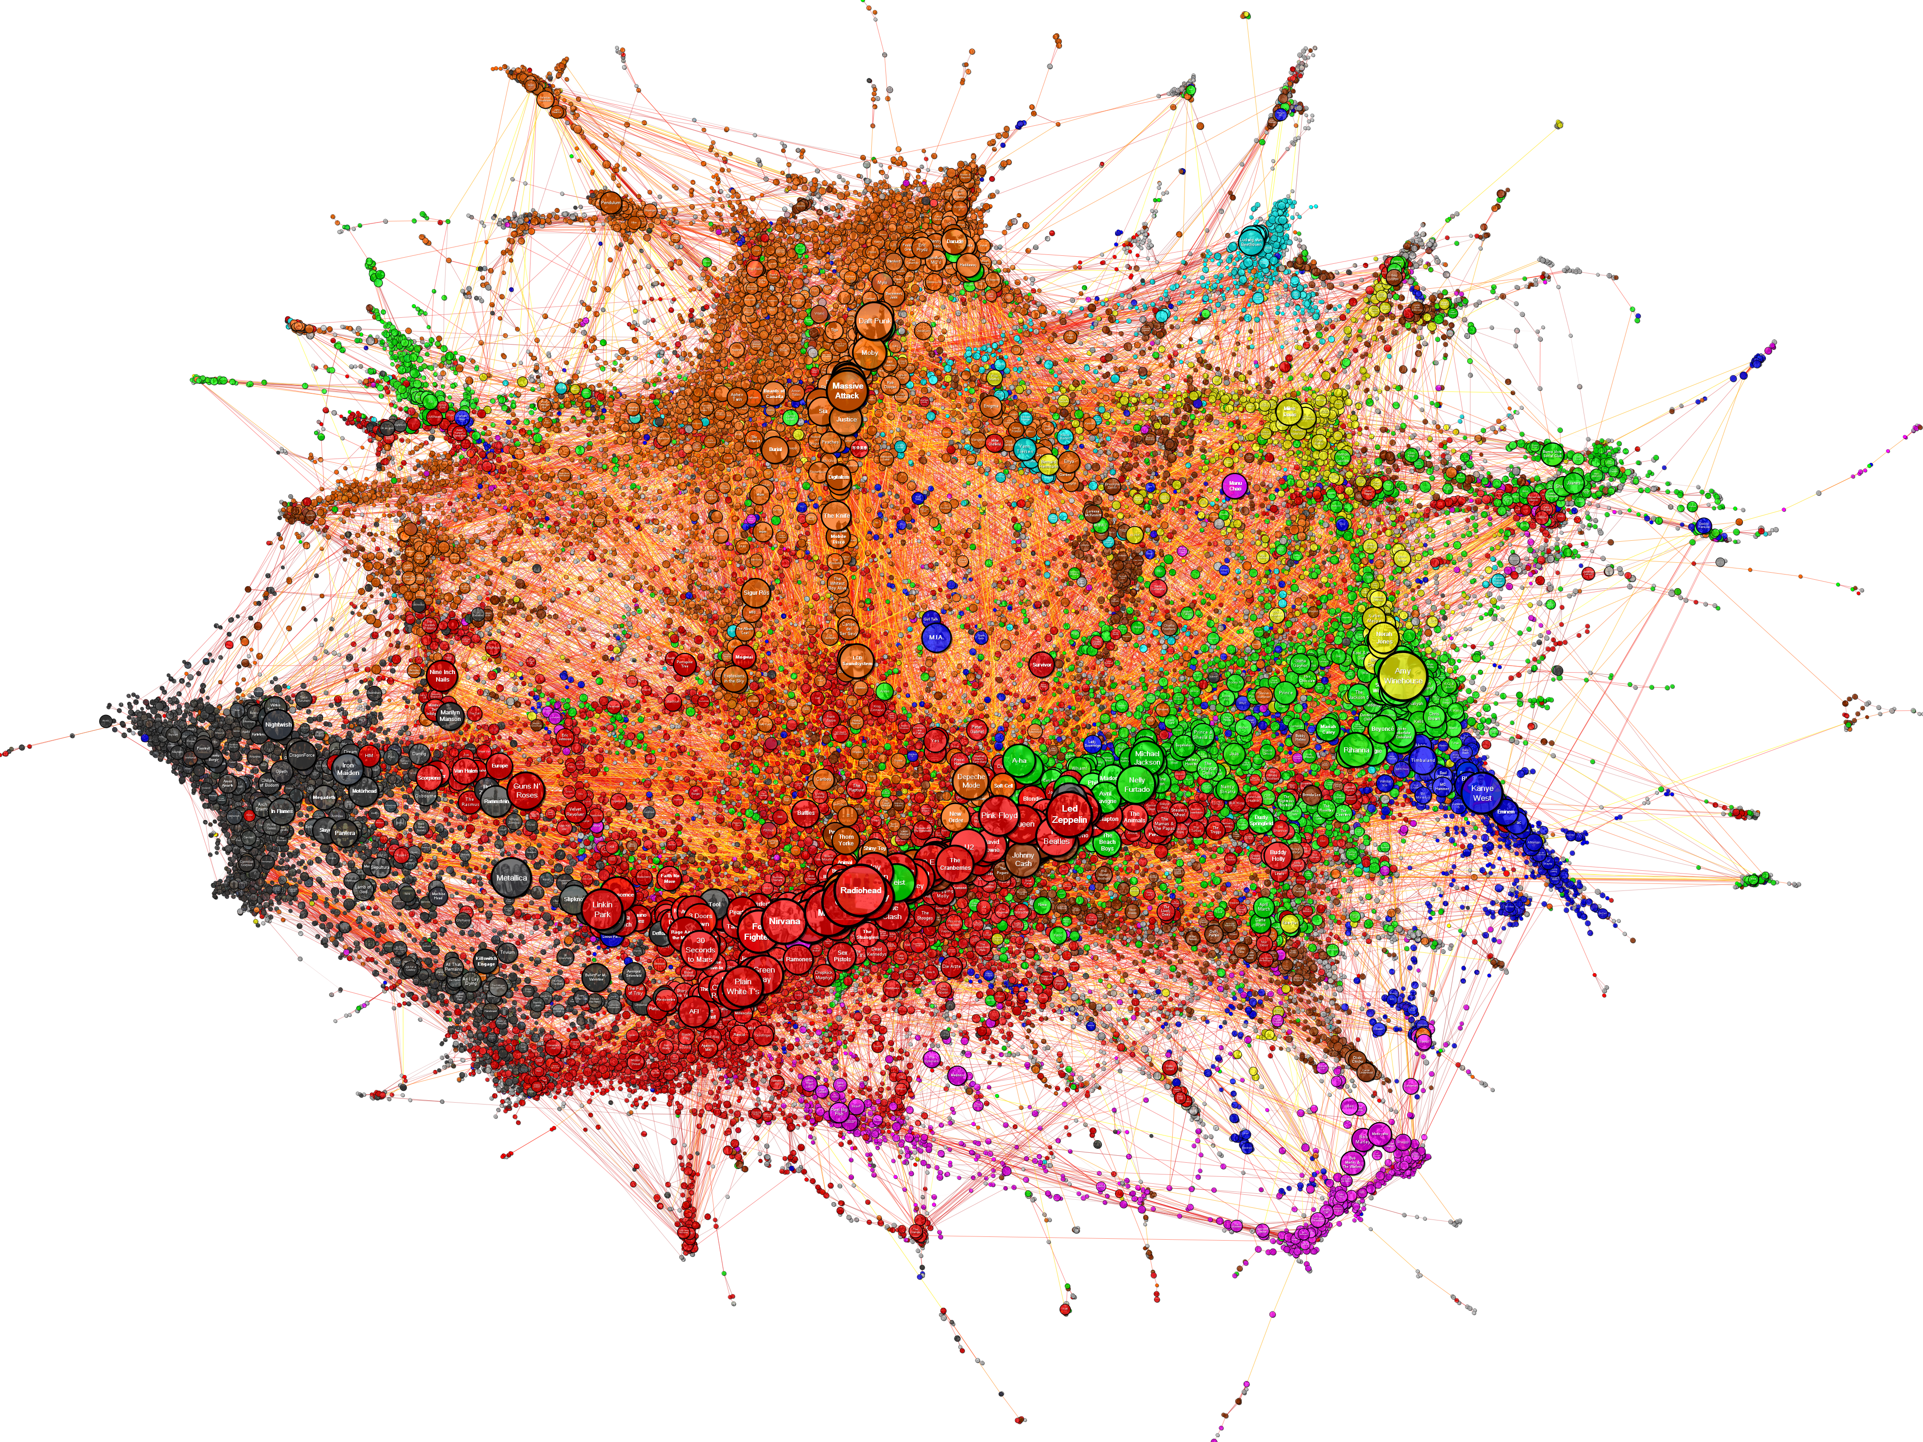
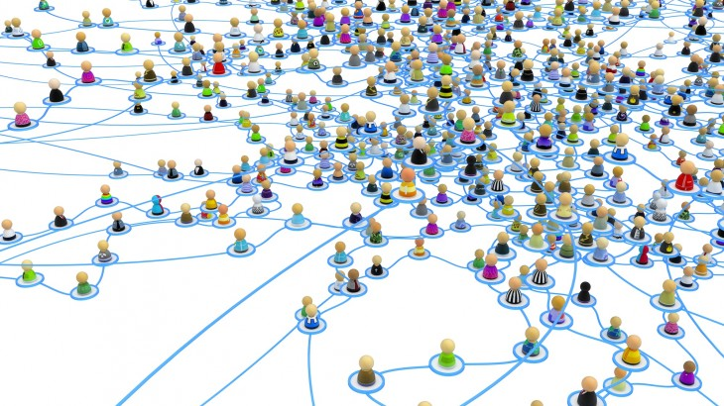
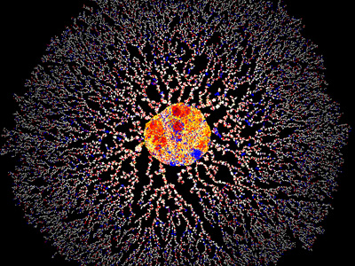
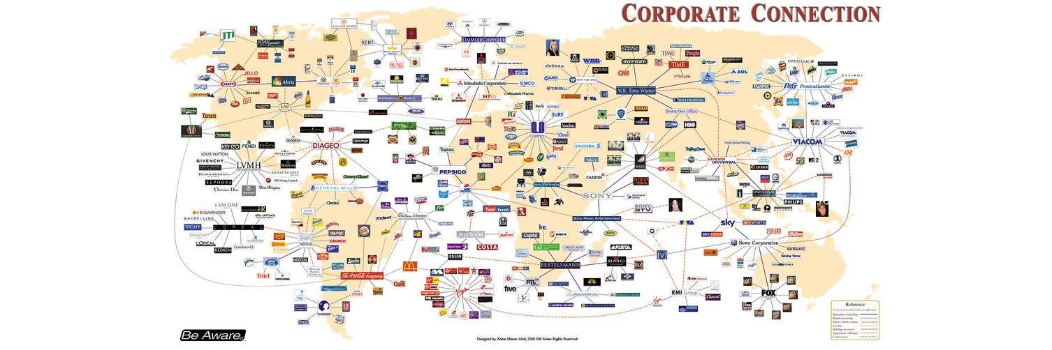
Big Graphs Are Everywhere
Social
network
Musicians on the internet
cooperation
network
Protein homology network
Notes:
Network represent relational data, we can collect this kind of data in many domain.
Music: this is a graph representation of the similarity relationships derived from the database of a music website
Protein network: Blue edges mean two proteins from the same species. Red edges mean … different …
Interchangeably: Networks, are often referred to as graphs in mathematics. So we use them interchangeably in this presentation.
Large in size:
Protein: 7 million edges
Facebook: 140 billion connections

Slide 3
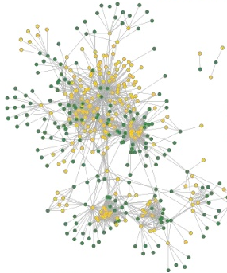
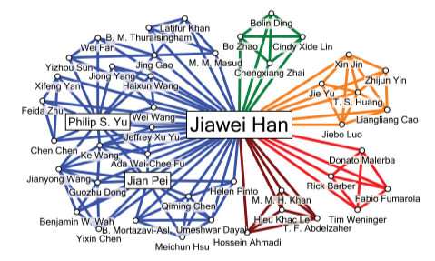
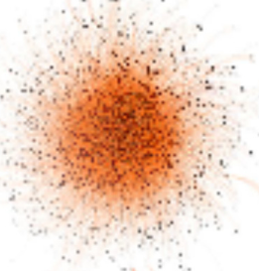
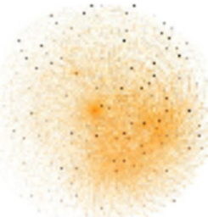
Communities Naturally Exist in Networks
Influential research groups
Customer with similar interest
Graph compression
Notes:
Communities:
A community is a small or large social unit (a group of living things) who have something in common, such as norms, religion, values, or identity.
Communities in networks: Nodes with a shared latent property, densely inter-connected
Such as finding the influential research groups, identify customer with similar interests, graph compression.
There are different definitions of dense subgraph, we focus on k-truss, because its cohesiveness and polynomial time complexity.

Slide 4
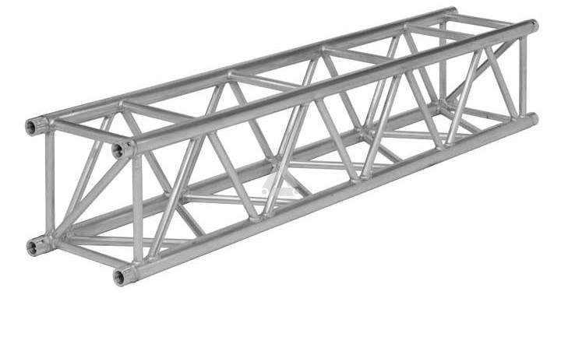
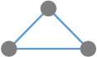
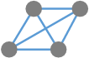
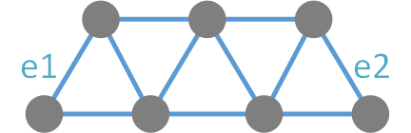
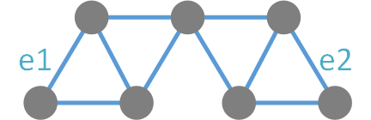
K-truss Community
Truss
K-truss definition
K-truss community
Maximal k-truss
Triangle connected [SIGMOD ‘14]
Trussness
3-truss
4-truss
Notes:
Triangle: fundamental building blocks of networks
k-truss of graph G: every edge in H is contained in at least (k-2) triangles within H.
It’s a word from engineering. Trusses are structures that typically comprise multiple triangular units.
What is a k-truss in a graph.
It’s a subgraph that each edge is included in at least k-2 triangles. For example …
We call k the trussness of the subgraph.
The trussness of an edge is the highest trussness of the k-truss communities it belongs to.

Slide 5
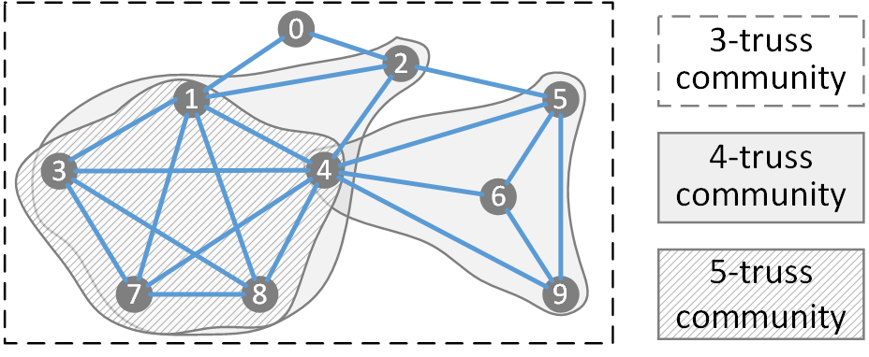
An Example Of K-truss Community
Notes:
Let’s look at an example of k-truss communities.
The pentagon forms a 5-truss as each of its edge is included in 3 triangles.
The whole graph is a 3-truss as all edges have at least 1 triangle.
Note that there are two 4-truss communities in this graph. As edge (2,5) is only included in 1 triangle (2, 4, 5), it is not in the 4-truss community. So edges from two 4-truss communities are not triangle connected with each other.

Slide 6
Related work
Community detection: finding all communities in the entire network
Non-overlapping community detection
Overlapping community detection
Community search: finding communities containing given query nodes
Notes:
Overlapping: a vertex may belong to multiple community
Non-overlapping community detection is better for partition purpose.
Overlapping community detection is more realistic in many scenarios such as social networks.

Slide 7
Our work
A different question: building index to answer community related queries without explore the exact community.
Given a set of query vertices, answer queries like:
With a specified k: are all query vertices belong to same truss communities with a specified k?
Max-k query: what are the communities with maximum k that all query vertices belong to?
Any-k query: what are all the communities that all query vertices belong to?
Previous works require search the exact community and then find if they all have intersections.

Slide 8
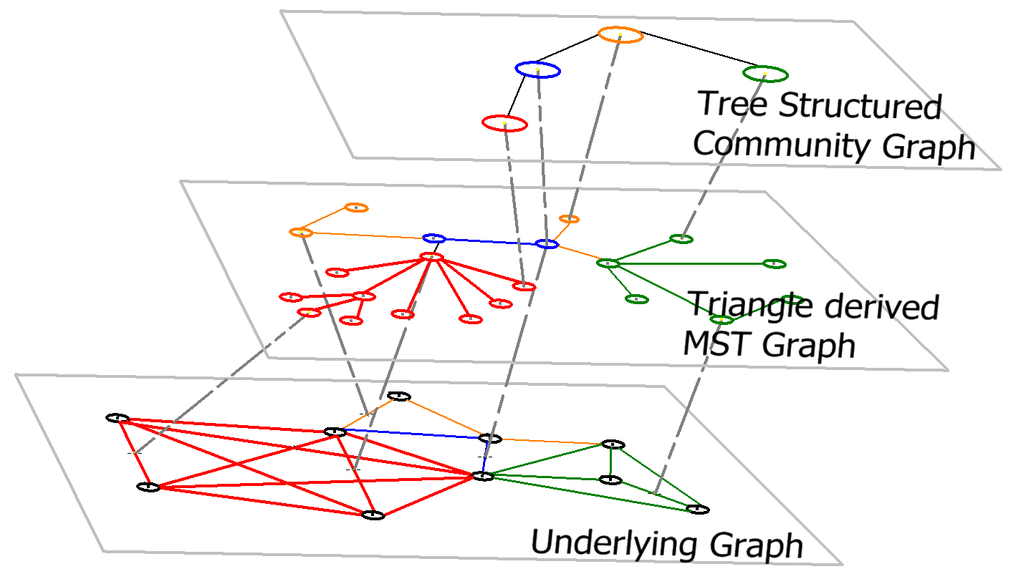
Two-layer Index Structure
Index
Layer 1
K-truss community info. query
Index
Layer 2
K-truss community search
Notes:
In our work, we propose a two layer index structure for k-truss community queries.
The first layer of index, which we call a triangle derived MST graph, can support k-truss community search with optimal time complexity which is bounded by the size of the community.
Although it has optimal time complexity for k-truss community search, it may still take a long time to answer a query when the size of the queried community is large. Very common in complex networks.
There are many applications that do not require the exact community, i.e. all the edges in the community. For example, given a set of vertices, are they belong to the same k-truss? What are the communities with highest trussness that they all belong to. Any index structure that need to first compute the exact community is cumbersome for this kind of applications.
We then propose the second layer of index, which we call tree structured community graph, that support such k-truss community information queries. It has a query time complexity that is only bounded by the size of the query sets and the maximum k.
Moreover, the tree structured community graph can be easily constructed from the triangle derived MST graph, with just a BFS traversal.

Slide 9

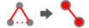
Triangle Derived MST Graph - Definition
A minimum spanning tree is generated from the original graph:
Edge vertex
Triangle adjacency edge
Triangle connectivity edge connectivity
Trussness weight
Notes:
The first layer of the index is a minimum spanning forest of the triangle derived graph.
We define the triangle derived graph as follows:
Edges is represented as vertices
Triangle adjacency is represented as edges, that is, if two edges belong to the same triangle, an edge is connecting them in the triangle derived graph.
Edge trussness is represented as vertex weight
The lowest edge trussness in a triangle is represented as the edge weight

Slide 10
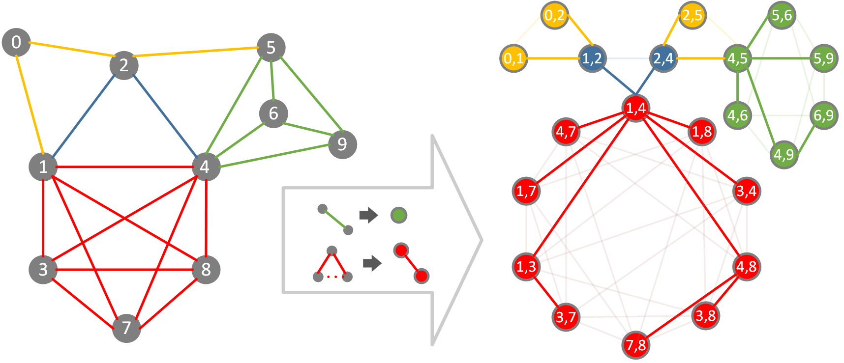
Triangle Derived MST Graph
K-truss community search: BFS with weight >= K
Notes:
Here we show an example a graph and its triangle derived MST graph.
Lets take a look at the green part for example. This part consist of 4 vertices and 6 edges in the original graph.
So in the triangle derived graph, we have 6 green vertices that represent edges in the original graph.
Each edge in the original graph is triangle adjacent to another 4 edges. For example …
So in the triangle derived graph, each vertex is connected to another 4 edges.
After we generate the triangle derived graph in this way, we can run krukal’s algorithm to get the maximum spanning tree of it.
In this example, we use transparent lines to represent discarded edges.
Now with the triangle derived MST graph, to perform a k-truss community search, one can simply run a BFS that only traverse edges with weight higher or equal to the required k.
Since it is a maximum spanning forest, so the number of edges is smaller than the number of vertices, so we can prove that the time complexity is optimal. It is bounded by the size of the queried community.

Slide 11
Tree Structured Community Graph - Definition
A tree structured community graph is built upon the triangle derived MST graph
K-truss community vertex
K-truss community inclusion relation edge
Can be constructed through one pass of BFS
Notes:
The second layer of the index is the tree structured community graph.
In this graph, each k-truss community is represented by a vertex, and the inclusion relations between k-truss communities is represented by edges.
The trussness of a community is represented by the vertex weight.
It can be proved that such a graph is a forest.
We design an algorithm that can generate such an index in one pass of BFS on the triangle derived MST graph.

Slide 12
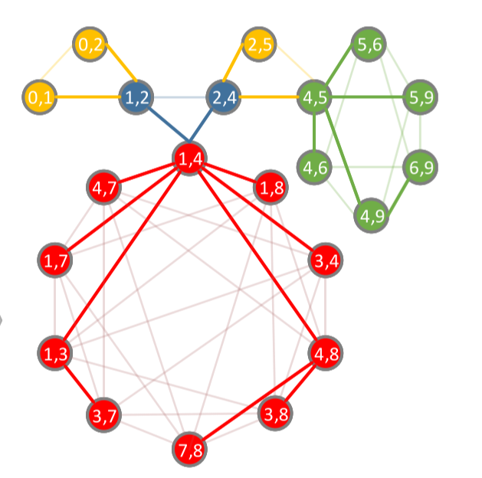
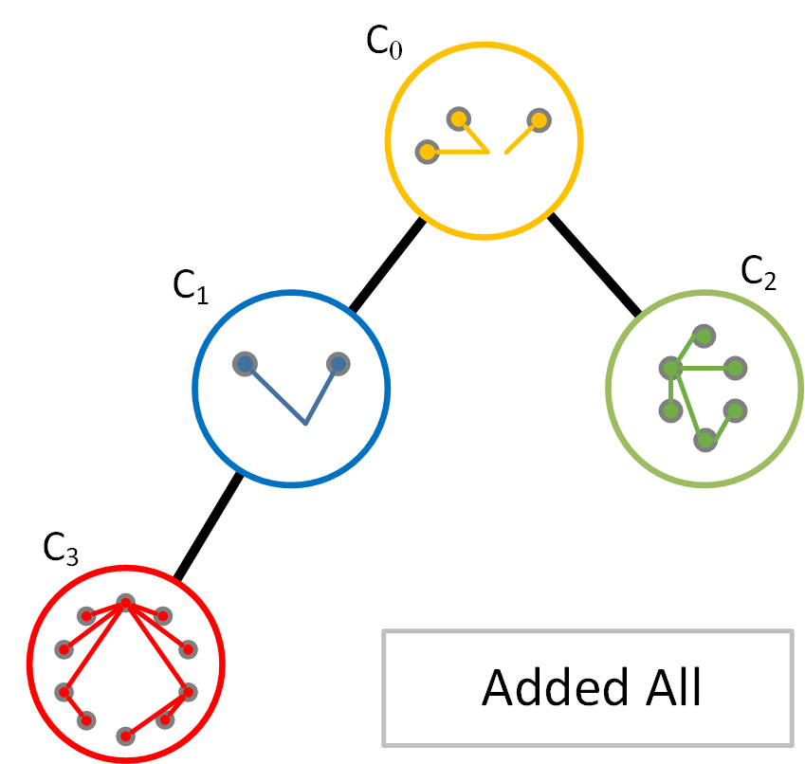
Tree Structured Community Graph
Each vertex in tree will only save a seed edge
Notes:
Here we show an example of the construction of the tree structured community graph.
In this graph, yellow represent 3-truss, blue and green represent two 4-truss and red represent the 5-truss.
Suppose the BFS start at vertex (1,4) and have already traversed (2,4). In this case, two communities (c1 and c3) have already been discovered by the algorithm and added as a vertex to the tree structured community graph.
Then the algorithm discovers ((2,4), (4,5)) when traversing neighbors of (2,4). The vertex (4,5) have weight of 4, however, the edge connecting (2,4) and (4,5) has weight of only 3. So instead of merging (4,5) to the existing community c1, it creates vertices for another two community c0 and c2 with weight 3 and 4 respectively.
After adding all vertices from the triangle derived MST graph, we have the complete tree structured community graph.
It can support queries such as k-truss, maximum k-truss and any-k-truss for a single or multiple query vertices with only basic operations of finding least common ancestors.

Slide 13
K-truss Query
Notes:
The smallest unit in k-truss is edge instead of vertex.
We can perform queries on vertices by first take the union of the communities of each neighbor edge.
We just use two edge as an example.

Slide 14
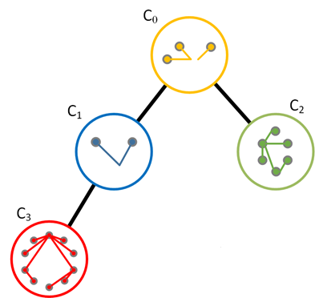
Query on the index
Step 2 (if exact community is needed) BFS with seed edge
Step 1 find least common ancestor
Notes:
Find the least common ancestor
Check if lca has trussness >= the required trussness value. This can answer most truss community related queries.
If exact community is required, perform BFS. (use bfs to avoid search through triangles and to avoid discover unnecessary triangles)

Slide 15
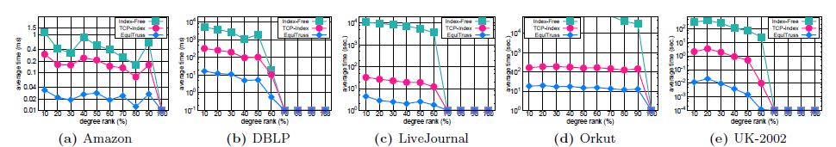
Results – Query time
Notes:
Find the least common ancestor
Check if lca has trussness >= the required trussness value. This can answer most truss community related queries.
If exact community is required, perform BFS. (use bfs to avoid search through triangles and to avoid discover unnecessary triangles)

Slide 16
References
[OSDI ‘12] Gonzalez, Joseph E., et al. "PowerGraph: Distributed Graph-Parallel Computation on Natural Graphs." OSDI. Vol. 12. No. 1. 2012.
[WWW ‘08] Leskovec, Jure, and Eric Horvitz. "Planetary-scale views on a large instant-messaging network." Proceedings of the 17th international conference on World Wide Web. ACM, 2008.
[Big Data ‘14] Fu, Zhisong, et al. "Parallel breadth first search on GPU clusters." Big Data (Big Data), 2014 IEEE International Conference on. IEEE, 2014.
[CIKM ‘10] A. Gubichev, S. Bedathur, S. Seufert, and G. Weikum. Fast and accurate estimation of shortest paths in large graphs. In Proceedings of the 19th ACM International Conference on Information and Knowledge Management, CIKM ’10, 2010.
[TKDE ‘14] M. Qiao, H. Cheng, L. Chang, and J. Yu. Approximate shortest distance computing: A query-dependent local landmark scheme. Knowledge and Data Engineering, IEEE Transactions on, 2014
[Nature ‘00] Kleinberg, J., Navigation in a Small World. Nature 406 (2000), 845.
[SIGMOD ‘14] Huang, Xin, et al. "Querying k-truss community in large and dynamic graphs." Proceedings of the 2014 ACM SIGMOD international conference on Management of data. ACM, 2014.

Slide 17
Thank you!

